Slide 1

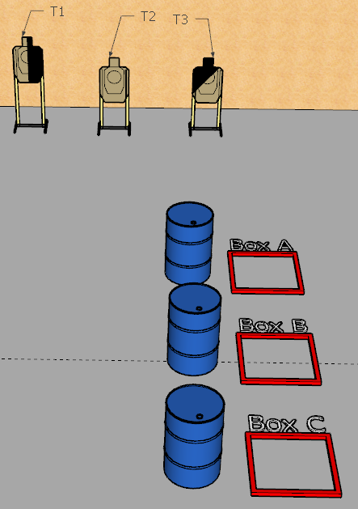
 | Interlake Sporting Association North Pistol, A Stage: Best Laid Plans Course Designer: Stanley Lewis & Marcel Englmaier
START POSITION: START POSITION: String 1: Firearm unloaded and placed on any barrel of competitor’s choice. All magazines to be used on the stage placed on remaining two barrels. Competitor starts standing behind the barrel that the gun starts on. Wrists below belt String 2: Handgun loaded & holstered, wrists below belt. (pcc: loaded, safety on, stock on belt, muzzle squarely downrange). Competitor standing in the box not used in String 1. Note: all magazines to be used must come from barrels. No stowing of magazines permitted within or between strings.
STAGE PROCEDURE: String 1: Retrieve and load firearm. Engage T1-T3 with 1 round each stronghand only. Move to another box and perform a mandatory reload, then engage T1-T3 with 1 round each weak hand only. String 2: Engage T1-T3 1 show only, freestyle. |  | STRINGS: 2 SCORING: Limited SCORED HITS: 9 START-STOP: Audible - Last shot

